Slide 1


Mental Health
Analysis

Slide 2




Team Members
1.K.Shahana - Team Leader
8208E23ASR049
2.B.Abisheak
8208E23ASR001
3.K.Balachandran
8208E23ASR011
4.B.Afrid Ahamed
8208E23ASR002
5.K.Mathan
8208E23ASR034
6.K.Subanraj
8208E23ASR056
7.N.Swathi
8208E23ASR061
8.A.Muthulakshmi
8208E23ASR036

Slide 3


Table of Content
01
02
03
04
Problem
Statement
Abstract
Analysis of
Dashboard
Country Wise Analysis
05
06
07
08
Workplace
Analysis
Physical Health
Analysis
Mental Health
Analysis
Final
Conclusion

Slide 4



PROBLEM STATEMENT
The growing prominence of mental health challenges within professional spaces has begun to reshape how organizations view employee welfare, performance, and long-term success. Yet, there remains a gap in understanding how these mental health issues differ across nations, workplace dynamics, and physical well-being. This project aims to bridge that gap by developing an interactive Power BI dashboard offering multi-dimensional insights into mental health through four key perspectives: country-wise analysis, workplace policy assessment, physical health impact, and mental health trend analysis. By visualizing these factors collectively, the dashboard empowers organizations, policymakers, and mental health advocates to make informed, data-driven decisions that promote healthier, more inclusive, and supportive work environments.

Slide 5




ABSTRACT
This project examines how workplace conditions influence employees' mental health and their decision to seek treatment. Using survey data, it analyzes factors such as mental health benefits, remote work options, leave policies, and employee background. The study finds that individuals with a family history of mental illness are more likely to seek treatment. Employees in the tech industry report higher mental health issues, possibly due to job stress or a more open work culture. Remote work increases treatment rates but makes accessing mental health leave more difficult. Notably, employees aged 31–35 experience the highest mental health challenges and work-related interference. The findings highlight the need to implement strong mental health support, flexible work options, and clear leave policies to foster healthier, more supportive workplaces.

Slide 6






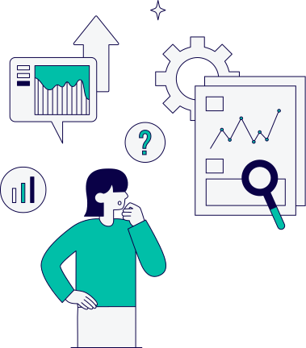


FOUR-DIMENSIONAL ANALYSIS
Country Wise Analysis
Workplace Analysis
Physical Health Analysis
Mental Health
Analysis

Slide 7
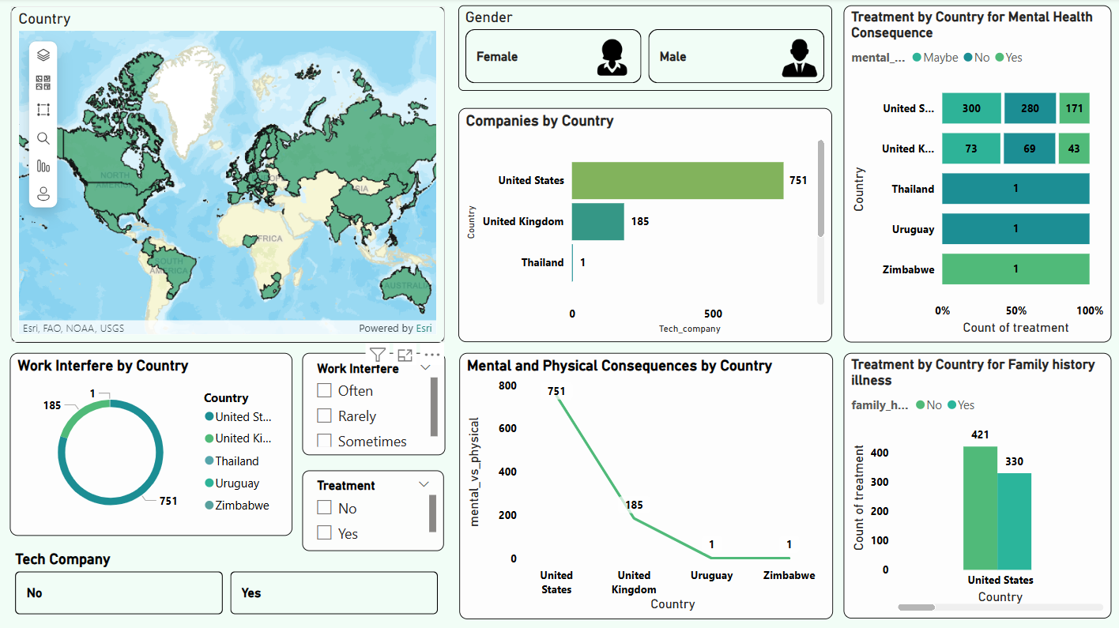

Slide 8



Country Wise Analysis
Charts
US Dominates in 751 companies — highest by far.
171 people have Mental Health Consequences in US.
Work Interference are Mostly reported in US, then UK.
Work Often Without Treatment is Common in Netherlands and UK.
330 People have Family History illness in US — high family history cases.
Mental & Physical Consequences in US highest, sharp drop in others.
Argcis Map
Gender Filter
Bar Chart
Stacked Bar Char
Doughnut Chart
Line Chart
Bar Chart
Slicers

Slide 9
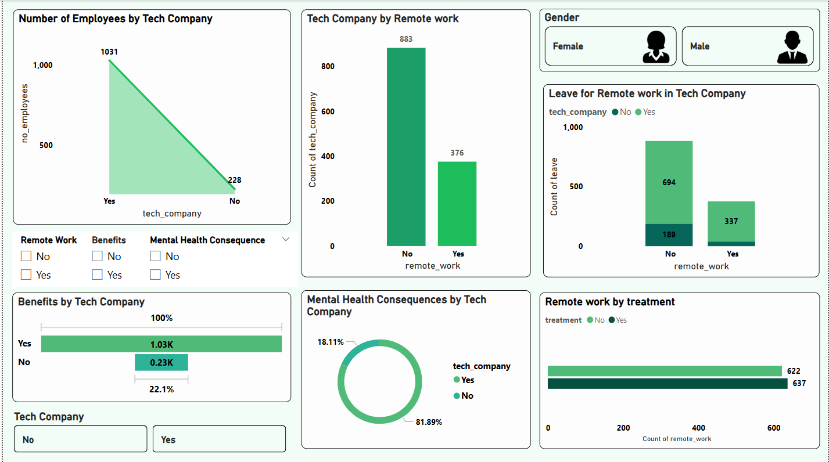

Slide 10

Workplace Analysis
Charts
1031 employees work in tech companies, 228 in non-tech.
883 don’t work remote, 376 work remote.
200 in remote work take treatment, 170 don’t.
637 employees working remote with treatment, 622 without — nearly equal.
337 leave approvals for remote work in tech companies, 694 for non-remote work.
80.89% face mental health consequences in tech companies.
Area Chart
Bar Chart
Icon Cards
Stacked Bar Chart
Horizontal Bar Chart
Doughnut Char
Horizontal Bar Chart
Slicers

Slide 11
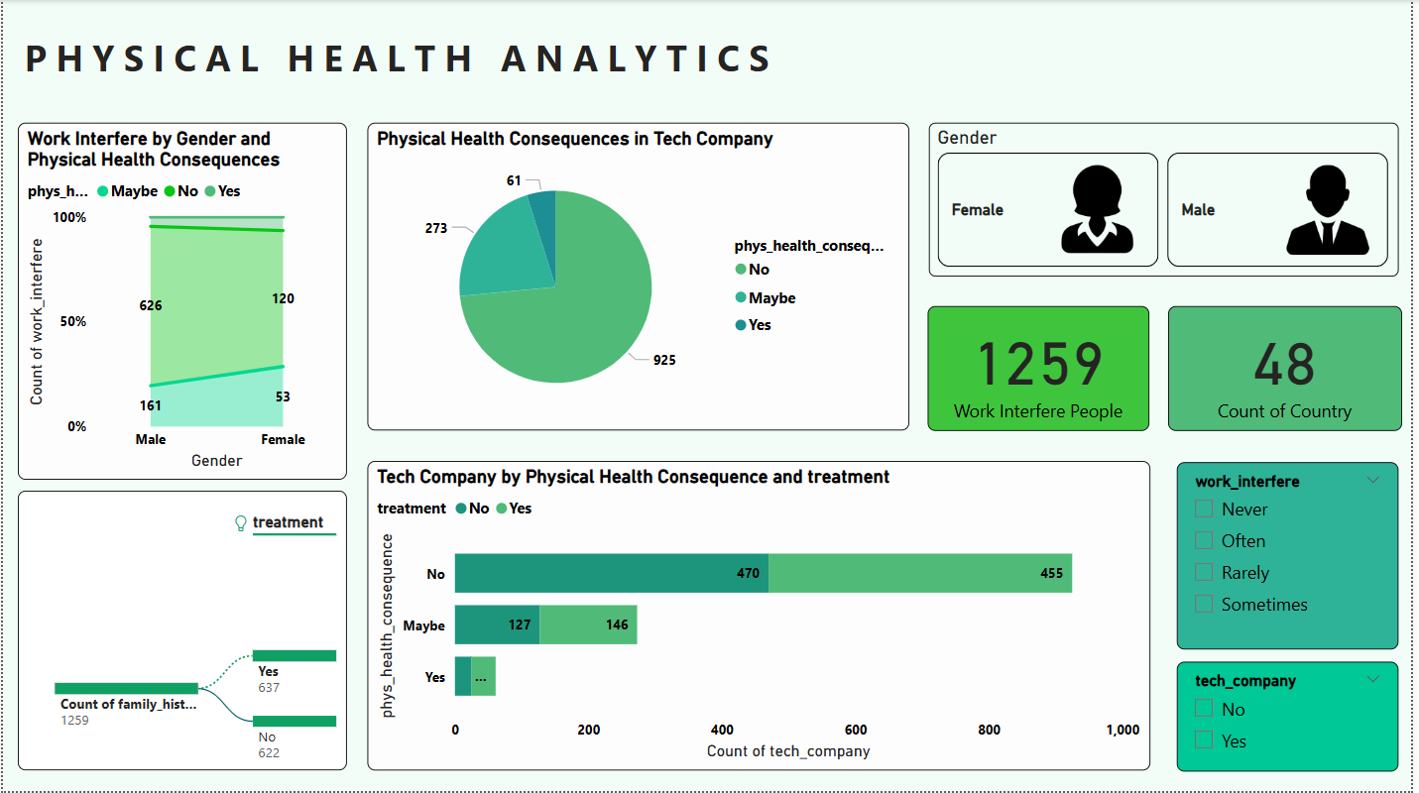

Slide 12
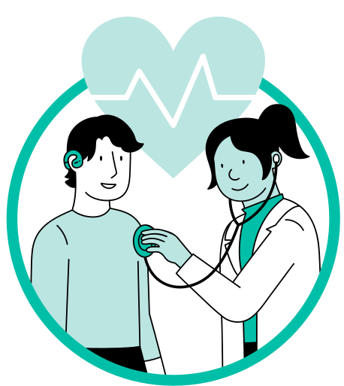
Physical Health Analysis
Charts
Males report more work interference.
Most report no physical health issues.
Both genders are represented.
1,259 experienced work interference.
Data spans 48 countries.
Family history links to higher treatment.
"No" group in Physical Consequence seeks more treatment.
Filters enable focused analysis.
Stacked Area Chart
Pie Chart
Icon Tiles
KPI Card
Decomposition Tree
Stacked Horizontal Bar Chart
Slicer / Filter Panel

Slide 13
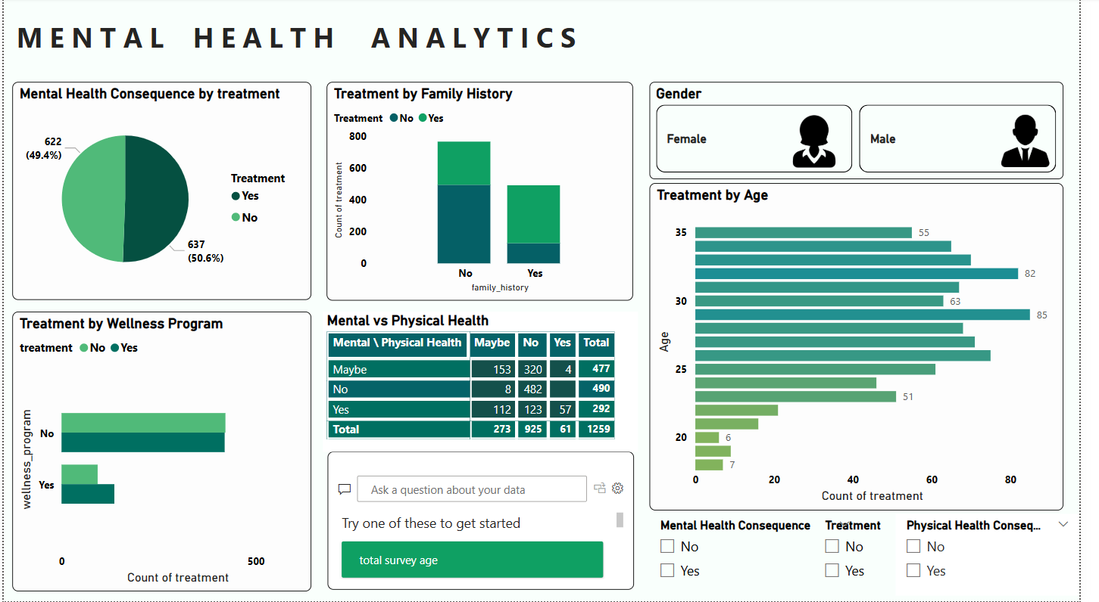

Slide 14

Mental Health Analysis
Charts
Almost equal people received and didn’t receive treatment.
Both genders are represented.
Ages 30–35 get the most treatment.
Most treated people aren’t in wellness programs.
Mental and physical health issues often overlap.
Filters help focus on specific health factors.
Pie Chart
Clustered Column Chart
Icon Tiles
Bar Chart (Horizontal)
Clustered Bar Chart
Matrix Table
Slicer Panel

Slide 15



Conclusion
Mental health issues are more common than physical ones.
50%+ report mental health consequences at work.
U.S. dominates tech employee count and reported issues.
Most work in tech companies, not startups.
Ages 30–35 need treatment the most.
Wellness programs slightly reduce treatment cases.

Slide 16

Solution
Awareness – Promote mental health education.
Access – Provide therapy and counseling support.
Training – Equip managers to handle mental health issues.
Flexibility – Allow remote/hybrid work and flexible hours.
Screenings – Offer anonymous mental health checkups.

Slide 17


Thank You!

